Slide 1
So, you wanna give a tech talk? David Makogon, Microsoft
#novacodecamp
@dmakogon
www.dmak.io

Slide 2
The intro…

Slide 3
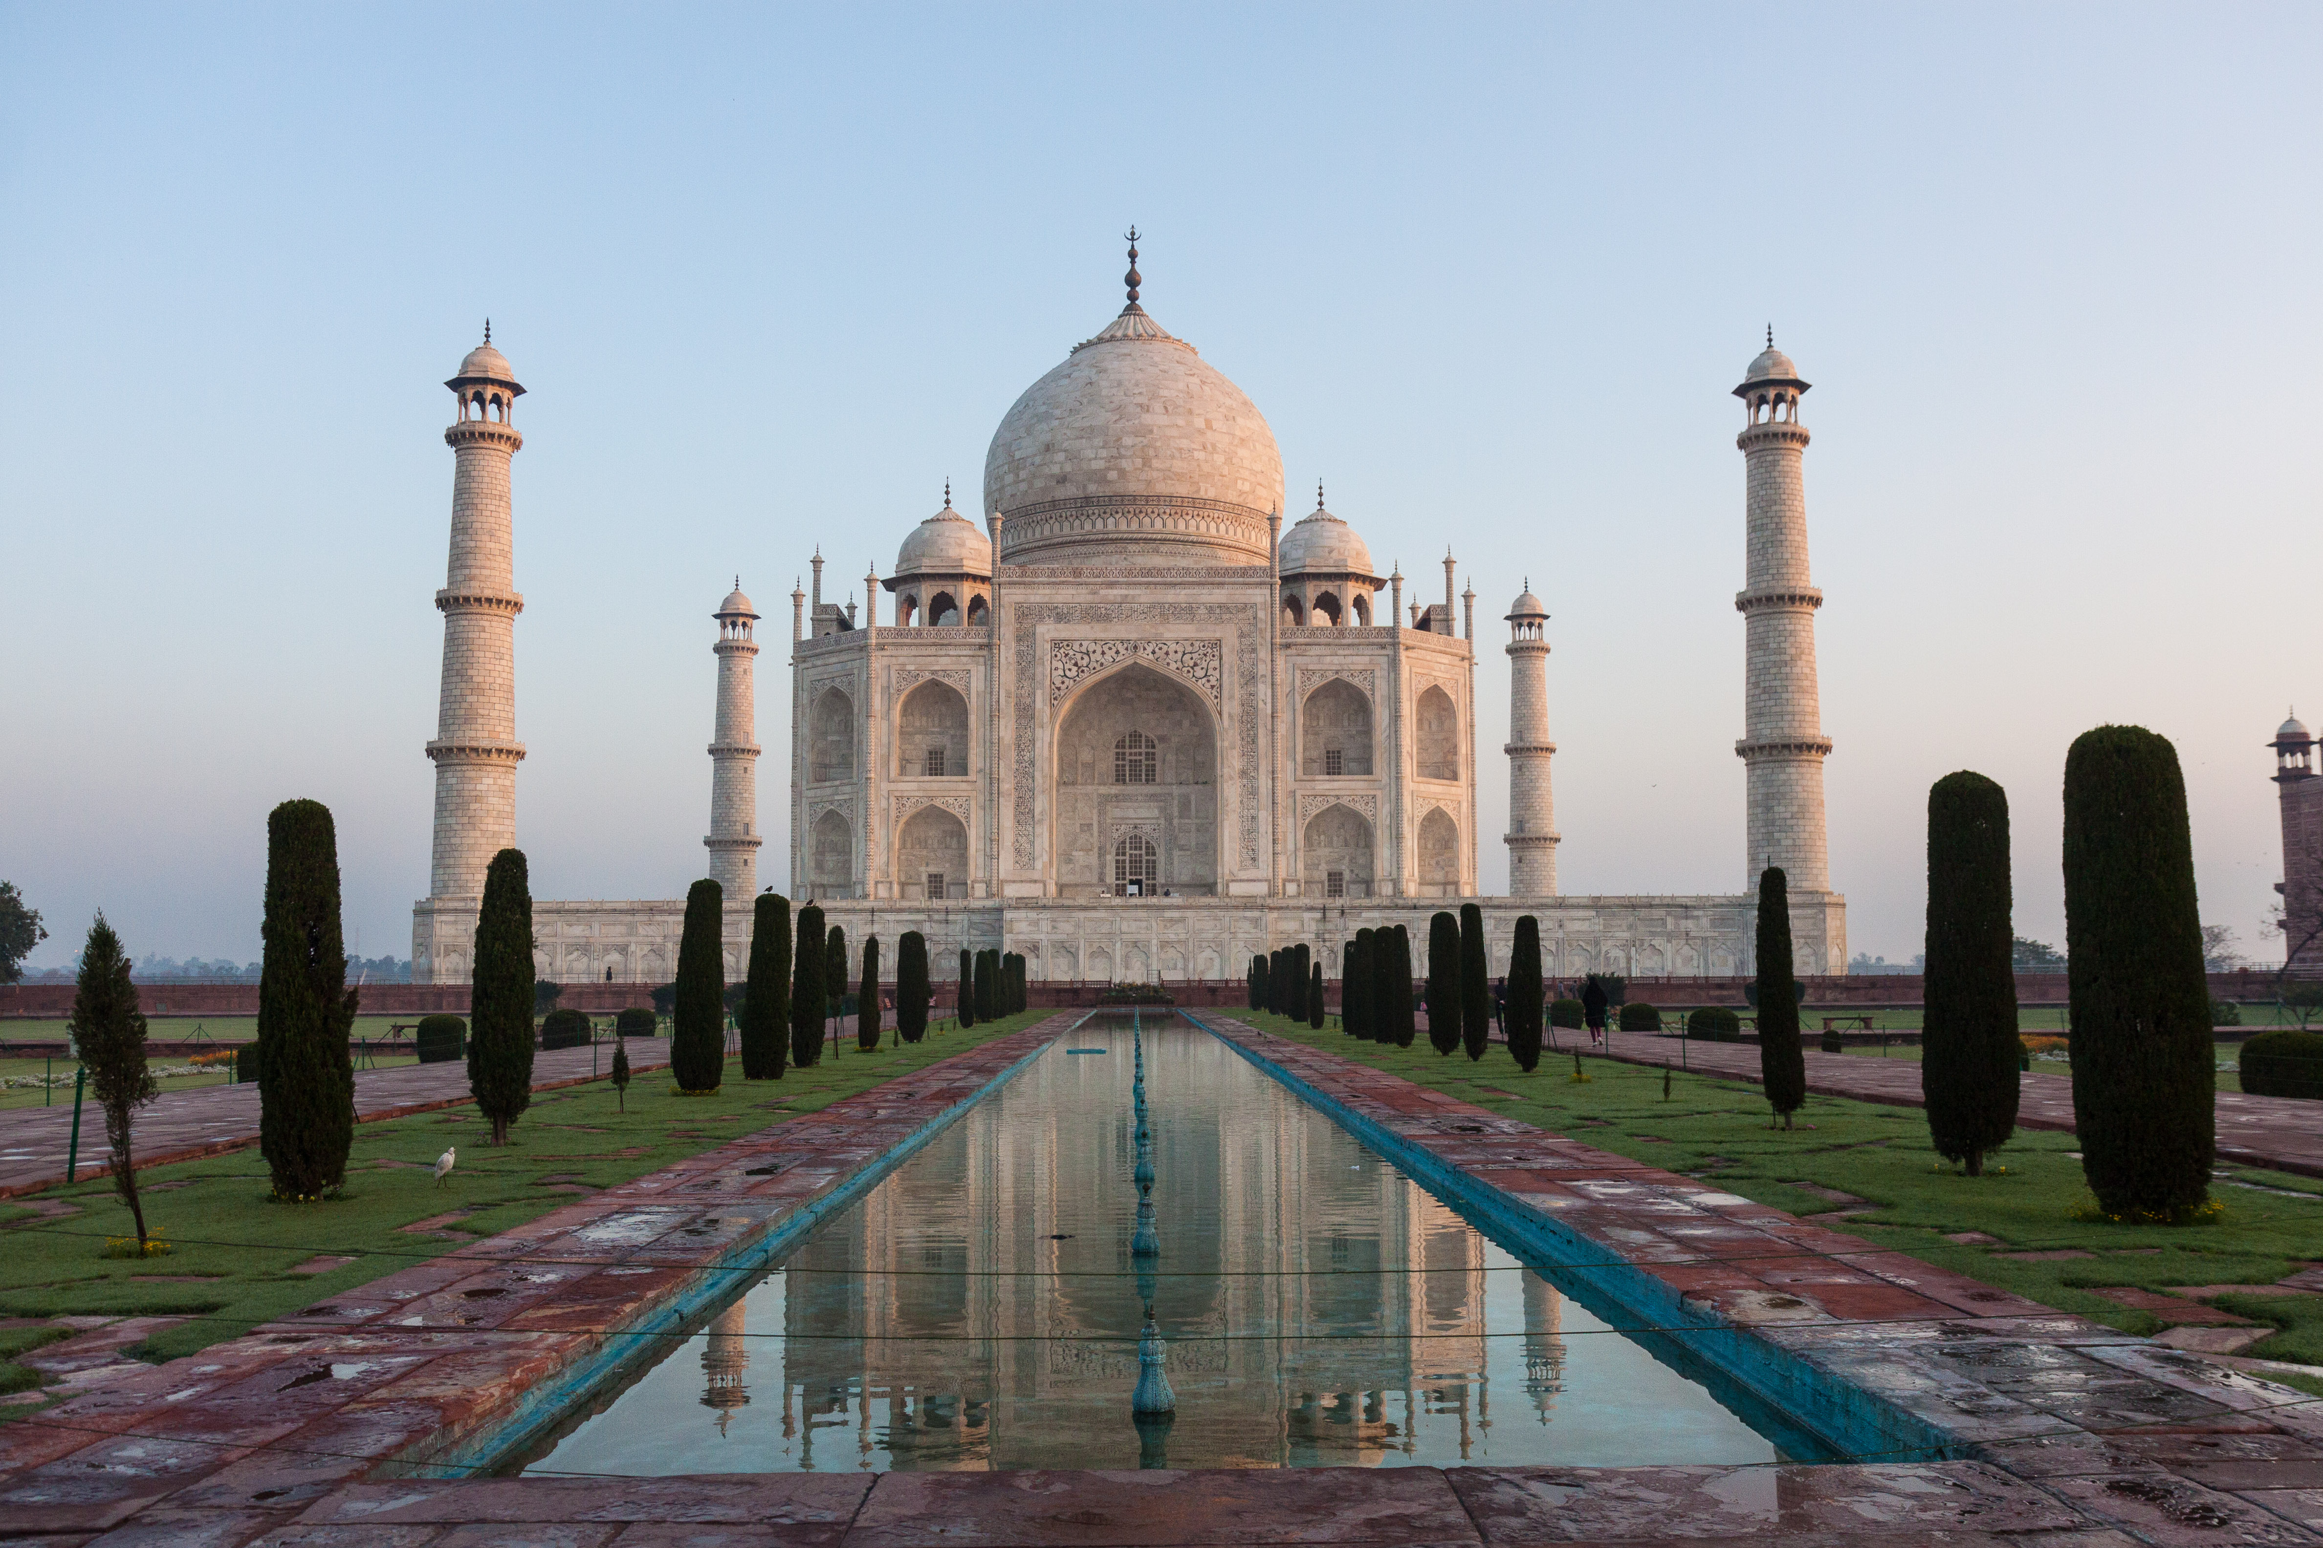

Who am I??? (hint: → David Makogon)
Azure architect
Camera carrier
Pun penner
NoSQL non-novice
Community congrat collector
- (World's first former) Azure MVP
- (Former) MongoDB Master
- Neo4j Ambassador
If there's one thing that's not clear to me, it's opaqueness.

Slide 4

Imagine that Great Amazing Thing you just worked on, and OH WHAT A STORY YOU COULD TELL! It has bells, whistles, drama, intrigue. There's some crafty code and a rarely-used workaround that could Change The World As We Know It! It talks about a new framework! And you have jokes! And pictures! And and and...
And... you have a huge audience filling seats. Different backgrounds. Different primary spoken language. Different eyesight & hearing. Different coding skills. Different attention spans. HOW WILL YOU SURVIVE!?!?
Having given, and watched, a huge bunch* of talks worldwide, I've learned many things that help (and hurt) presentations. In this talk, I'll attempt to use the "things that help" to show you things that help AND things that hurt** in hopes that all of our future talks can help more and hurt less.
*Huge bunch : a ridiculously-high number that gets larger every time I tell the story ** These things don't really hurt. But they may make you cringe. Or sigh. Or gasp.

Slide 5
Real simple agenda
Speaking tips n tricks (really, that's it)
Primarily for tech talks
Sorta applies to all talks

Slide 6
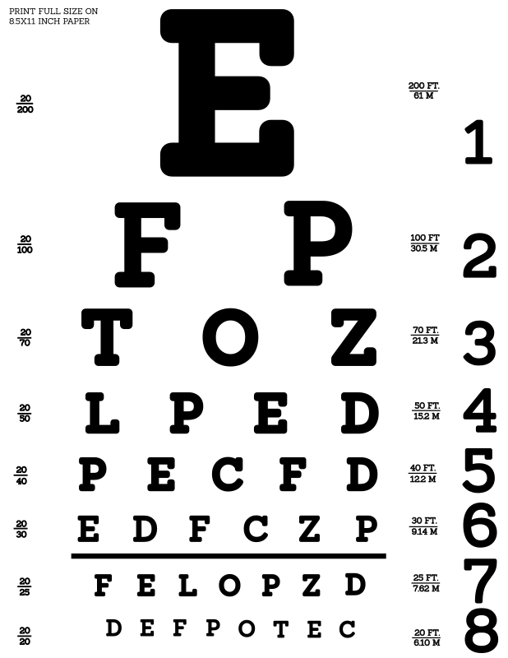
Eye charts

Slide 7
Obligatory "bullet" eye-chart slide
Think about the content you're showing. Do you really need bullets at all? Does the little dot on the left help, or just look like annoying dots down the page?
Should bullets be shown all at once, or slow-rolled so that your audience can follow along?
Do you really need to write entire paragraphs to get your point across, or maybe you could just reduce to a few key words?

Slide 8
Bullets (or not)
Bullets: Yay nor nay?
Make your point

Slide 9
Fonts (and code)
view.on('init', function (next) {
var q = keystone.list('Post').paginate({
page: req.query.page || 1,
perPage: 10,
maxPages: 10,
filters: {
state: 'published',
},
})
.sort('-publishedDate')
.populate('author categories');
if (locals.data.category) {
q.where('categories').in([locals.data.category]);
}
q.exec(function (err, results) {
locals.data.posts = results;
next(err);
});
});
var q = keystone.list('Post').paginate({
page: req.query.page || 1,
perPage: 10,
maxPages: 10,
filters: {
state: 'published',
},
})
.sort('-publishedDate')
.populate('author categories');
Keystone.js – blog post listing
view.on('init', function (next) {
var q = keystone.list('Post').paginate({
page: req.query.page || 1,
perPage: 10,
maxPages: 10,
filters: {
state: 'published',
},
})
.sort('-publishedDate')
.populate('author categories');
if (locals.data.category) {
q.where('categories').in([locals.data.category]);
}
q.exec(function (err, results) {
locals.data.posts = results;
next(err);
});
});

Slide 10
Code editors and shells…

Slide 11
Human interaction

Slide 12
Know your audience
Skill level and background
Primary language (in general)
Assignment: look around you

Slide 13
Jokes
Political
There are 10 types of people:
Those who understand binary… And those who don’t
Off-color
Adult
Country-specific

Slide 14
Your voice
The volume
The direction
The mic
Notes:
Mic: learn to turn off (drinking, coughing)
Don’t face the screen when talking
Project your voice if no mic.
Always use mic! Clip-on is best
Remember the back of the room

Slide 15
Your location
Where are you hiding???
Are you moving?

Slide 16
Highlighting
Pointing devices
Zooming
Hand gestures
“As you can see…”

Slide 17
Terms and acronyms
Don’t assume people know them!

Slide 18
Dealing with questions
Repeat
Repeat
Repeat
Repeat
Repeat
Repeat
Repeat
Repeat
It’s ok to cut short
(politely)

Slide 19
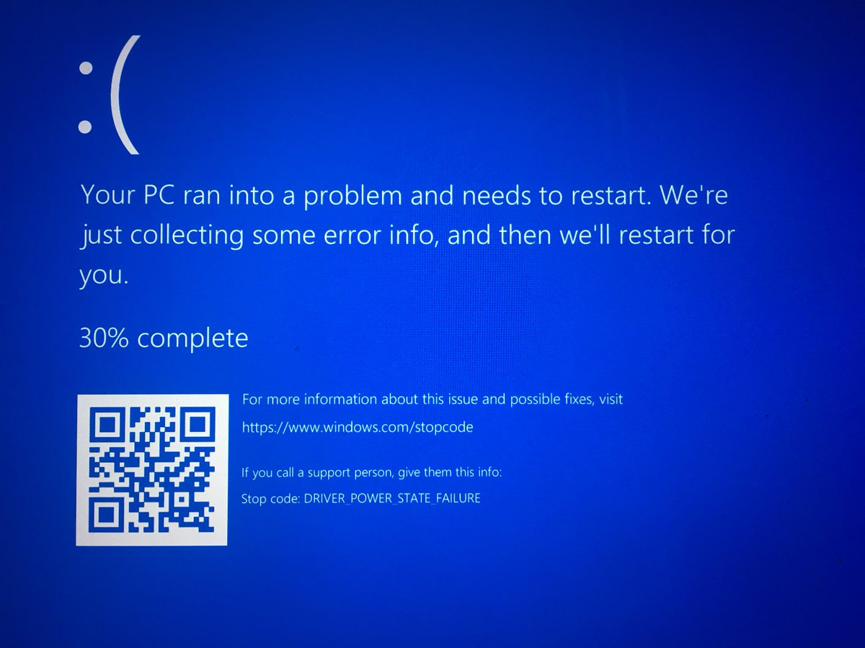

Slide 20
Dealing with problems

Slide 21
Dealing with problems
Computer crash
Network failure
Mouse failure
Clicker failure
Demo failure
“Dead air”

Slide 22
Computer crash
Assume complete failure
Backup computer?
Whiteboard?
Just… speaking?

Slide 23
Network failure
Most demos can be run locally
Cloud? Tricky
Local emulators
Local databases
Local web/app servers

Slide 24
Demo failure
Won’t compile?
Throws errors?
Live coding is risky. Awesome, but risky.
Backup project, pre-tested

Slide 25
Dead air
Some things take a while
Some things require typing
Narrate
Talk through things

Slide 26
Pre-talk prep

Slide 27
Rehearsing and timing
New talk? Rehearse. A LOT.
Old talk? Rehearse. Just do it.
Clock time: don’t use it all.
Q&A
Unforeseen problems
Schedule delays

Slide 28
Where is a clock?
Countdown timers are great!

Slide 29
Checklist - hardware
Laptop(s) + Power adapters
Video adapters
Network adapter
Hotspot
Clicker / pointer / mouse
Batteries (charged, plus extras)

Slide 30
Checklist - software
Apps installed
Code downloaded / cloned
Directory-jump quick-links
Start / test utilities (e.g. ZoomIt)
Configure WiFi
Azure? Test non-web ports
Timezone

Slide 31
Checklist – non-essentials
Shut down email / chat
Shut unneeded browser tabs
Turn off:
screen savers
notifications
sleep

Slide 32
Checklist – personal
Clothing
Water/soda available
Stress toys / spinners
Props?
Are you ok being recorded?

Slide 33
Checklist – before presenting
Screen test / resolution test
Microphone test
Network test
Code / text display test
Notes available
Bathroom break

Slide 34
Ready, set, present!

Slide 35
Summary
The intro
Avoiding eye charts
Code editors and shells
Human interaction
Dealing with #fail

Slide 36
Questions?
Keep in touch!
Twitter: @dmakogon
Blog: dmak.io
Talk stuff at github.com/dmakogon/novacc2017.2

